Slide 1



Versioned Document Tracker with Undo/Redo Operations
Name : AKASH YADAV
Registration No :12310801
University : LPU
Duration : June 10 – July 16, 2025

Slide 2

CONTENTS
1. Introduction
2. Objectives
3. Technology Stack
4. System Architecture
5. Key Modules
6. Core Features
7. Learning Outcomes

Slide 3

1. Introduction
My project is a C++ console-based application demonstrating
OOP and DSA Structure implementation “specifically stacks
And file handling for version tracking.”

Slide 4
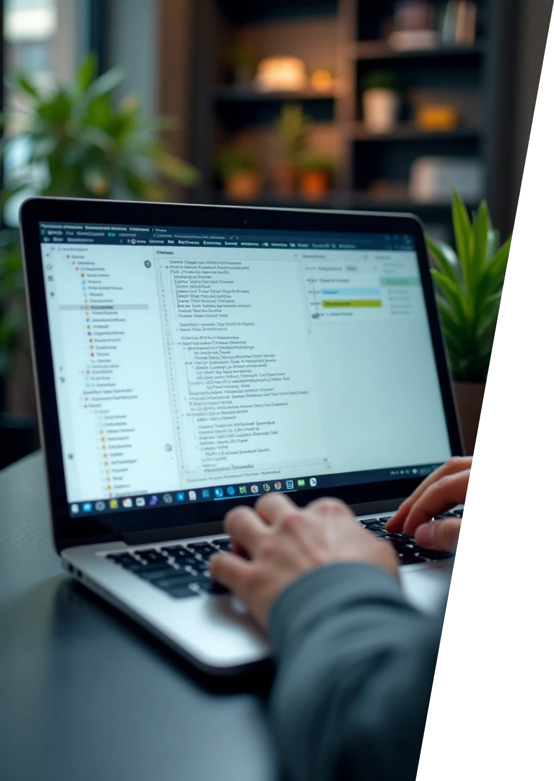
What is Versioned Document Tracker?
A tool designed for tracking changes and managing multiple versions of documents.

Slide 5
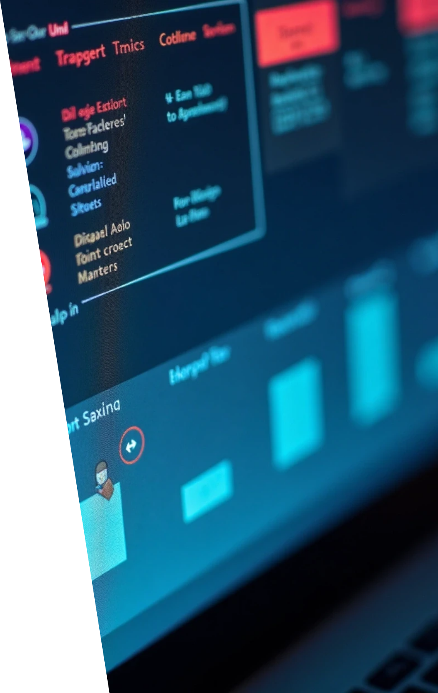



Key Features
1
2
Undo
Redo
Revert the last action.
Reapply the last undone action.
3
4
Save/Load
Version History
Save the document's current state or load a previous version.
Keep track of all document versions.

Slide 6


Technologies
C++
OOP
Data Structures

Slide 7

2. Objectives
Design
Design a lightweight version control system.
Implement
Implement Undo/Redo using stacks.
Simulate
Simulate modern text editor features.
Enhance
Enhance C++ programming skills.

Slide 8

3. Technology Stack
Programming Language
C++ (C++11 or above)

Slide 9


Data Structures
Stack

Slide 10
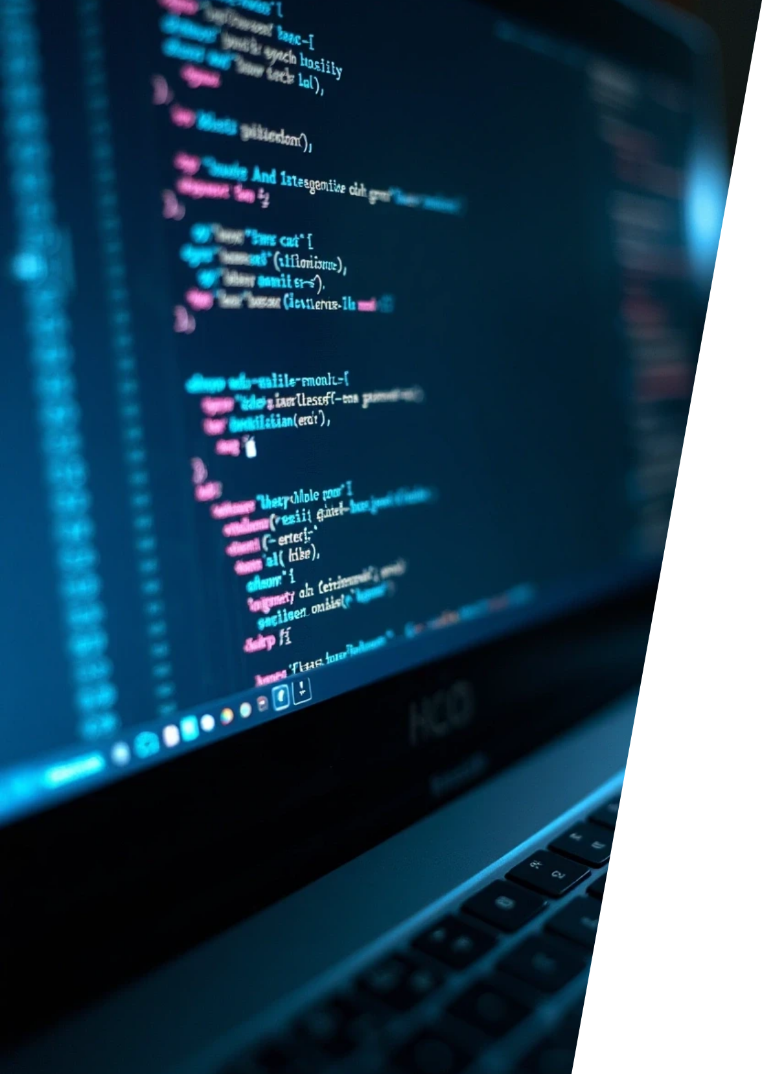

Concepts
OOP
Dynamic Memory Management

Slide 11

IDE
Code::Blocks/Dev-C++/VS Code

Slide 12

Platform
Windows/Linux

Slide 13
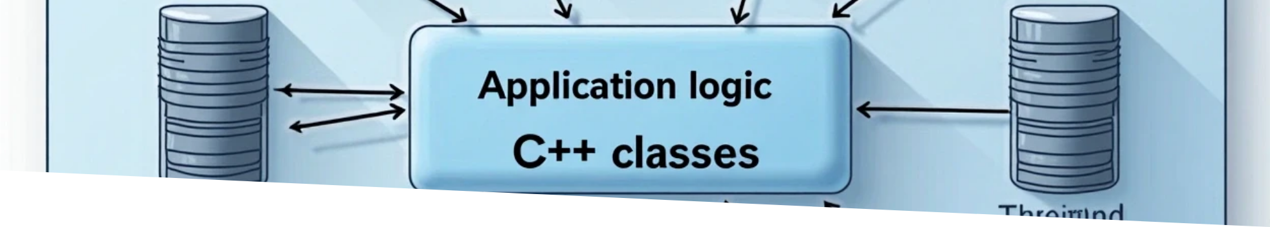
4. System Architecture
Frontend (Terminal UI)
↓
Application Logic (C++ Classes)
↓
Data Storage (Stacks)

Slide 14


5. Key Modules
Document Module
Version Control
User Interface
File Handling
Manages current document state.
Undo/Redo stacks.
Console-based commands.
Save/Load operations.

Slide 15
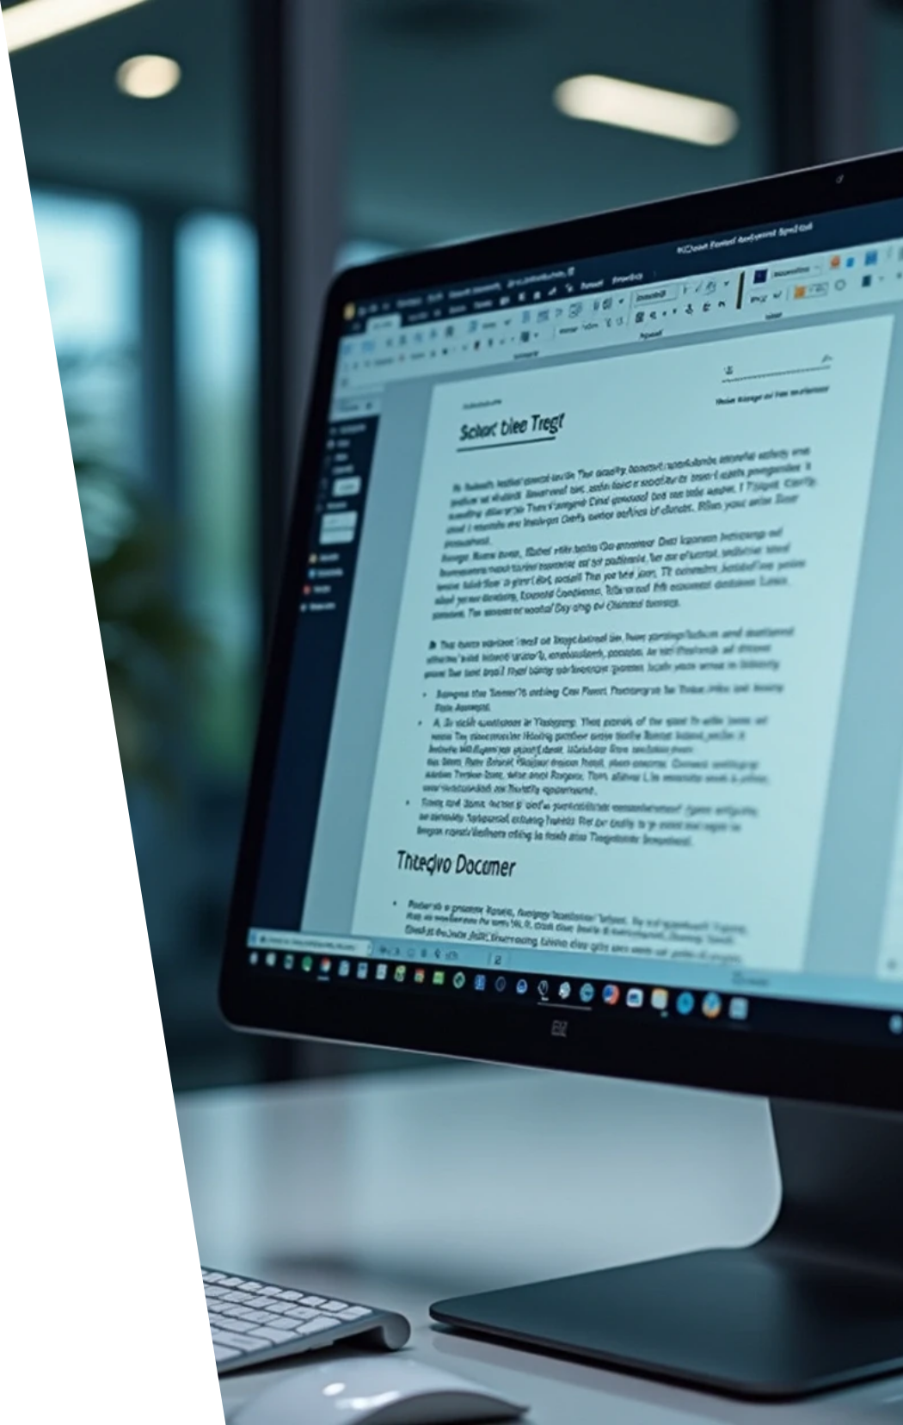


6. Core Features
1
2
3
✅ Insert Text
✅ Delete Last Line
✅ Undo/Redo Operations
4
5
6
✅ Display Document
✅ Save/Load from File
✅ Clear Document

Slide 16



7. Learning Outcomes
Enhanced C++ programming skills.
Practical OOP implementation.
Data structure applications.
Problem-solving approach.
Software design principles.

Slide 17
Thank You

